Slide 1
Cancer Rates NHS Borders
Monica Kadwe

Slide 2
Beating cancer: ambition and action
The Scottish Government cancer strategy containing more than 50 actions to improve cancer services across Scotland.
Launched in March 2016
Commitment to spend £100 million over 5 years to improve the prevention, detection, diagnosis, treatment and aftercare of those affected by cancer.
What would success look like?
More people surviving cancer for 1, 5 and 10 years
Closing the gap in survival rates between Scotland and the best countries in Europe
A reduction in cancer health inequalities
People with cancer and their families feeling involved in decision making and able to make the right decisions for them on the basis of full information
A radical improvement in experience and quality of life, including at the end of life
A reduction in the growth in the number of people diagnosed with cancer
More equitable access to services and treatment

Slide 3
Cancer waiting times
If you're an adult with a newly diagnosed primary cancer type (such as breast, lung, head and neck) your health board should provide treatment within the following time scales:
Within 31 days from when the decision was made to treat your cancer
Within 62 days from being referred urgently with suspected cancer
These timescales include referrals from national cancer screening programmes.
You can ask NHS staff if your cancer treatment is covered by the national waiting standard.
Source: https://www.nhsinform.scot/care-support-and-rights/health-rights/access/accessing-and-using-the-nhs-in-scotland

Slide 4
Dataset Source
Cancer incidence data - https://www.opendata.nhs.scot/dataset/annual-cancer-incidence
Geography health board labels lookup - https://www.opendata.nhs.scot/dataset/9f942fdb-e59e-44f5-b534-d6e17229cc7b/resource/652ff726-e676-4a20-abda-435b98dd7bdc/download/geography_codes_and_labels_hb2014_01042019.csv
Source: https://www.opendata.nhs.scot/

Slide 5
Dataset information
Incidence by Health Board.csv
Mortality by Health Board.csv
Cancer Wait Time - 31 Day Standard
Cancer Wait Time - 62 Day Standard
NHS Borders- S08000016
All cancer types
Male and Female
2010 - 2021

Slide 6
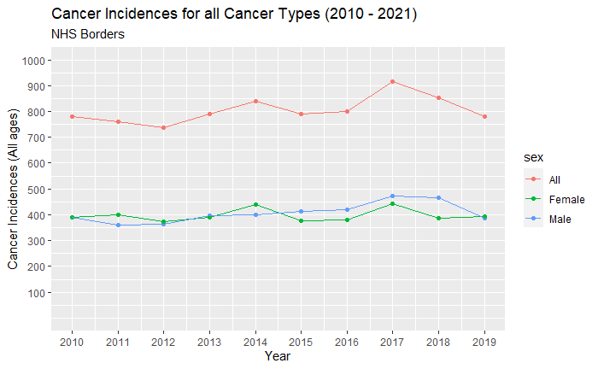
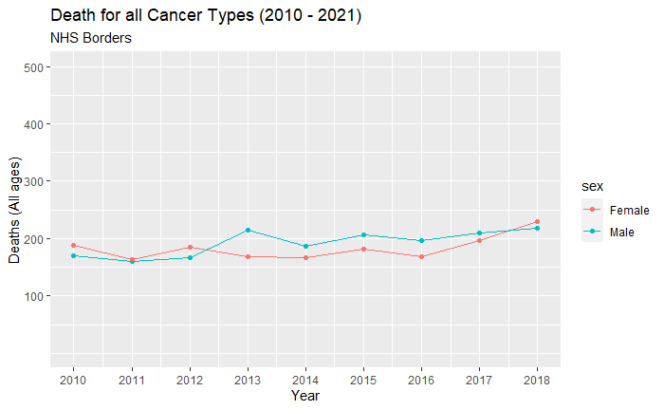
1st observation

Slide 7
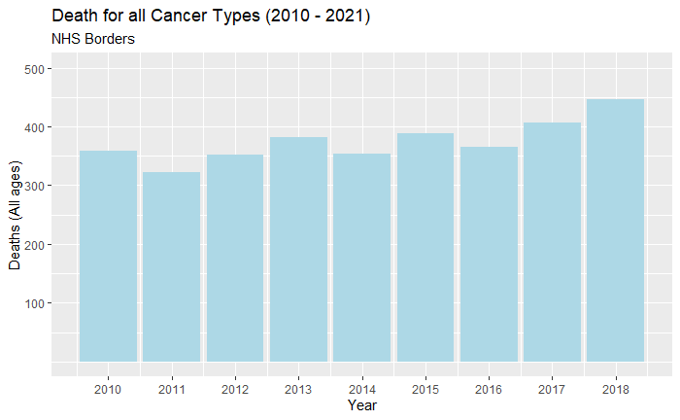
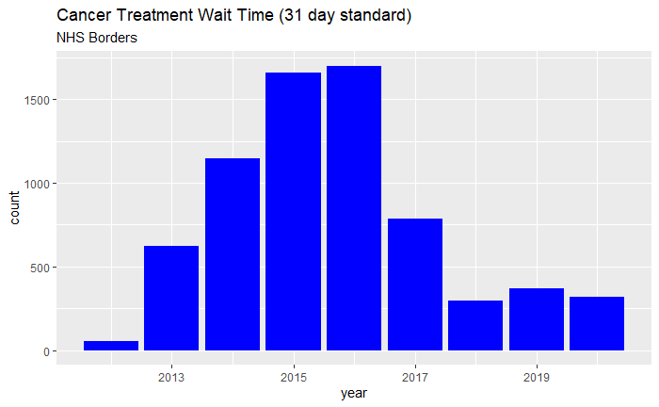
2nd observation
Year death_count
2010 358
2011 323
2012 352
2013 382
2014 353
2015 389
2016 365
2017 406
2018 447

Slide 8
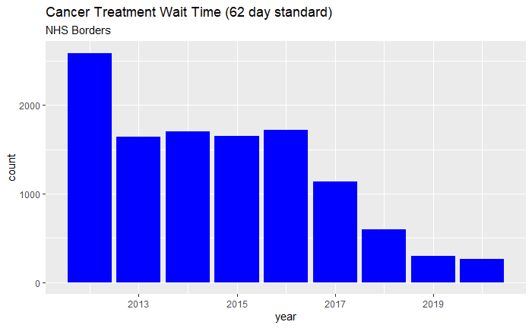
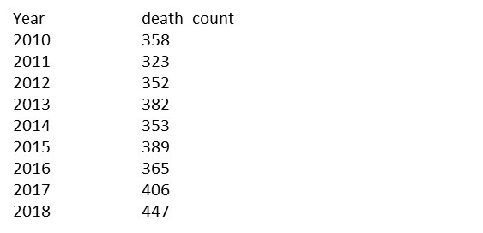
3rd observation

Slide 9
Fact check
Latest cancer treatment waiting times are 'worst ever’(Published26 June 2018) – BBC
(https://www.bbc.co.uk/news/uk-scotland-44564359)
Borders General Hospital cancer centre expansion approved
(https://www.bbc.co.uk/news/uk-scotland-south-scotland-41239273)
Strong Performance in Cancer Waiting Times
(http://www.nhsborders.scot.nhs.uk/patients-and-visitors/latest-news/2020/december/31/strong-performance-in-cancer-waiting-times/)
Over 97% of eligible patients - 62-day target. This is well above the average for Scotland as a whole (by ten percentage points).
100% of Borders patients - 31-days (from the date of the decision to treat), which is again higher than the average achieved for Scotland as a whole.

